Slide 1

Comparison of Multilayer RNN, LSTM, and GRU on MNIST

Slide 2
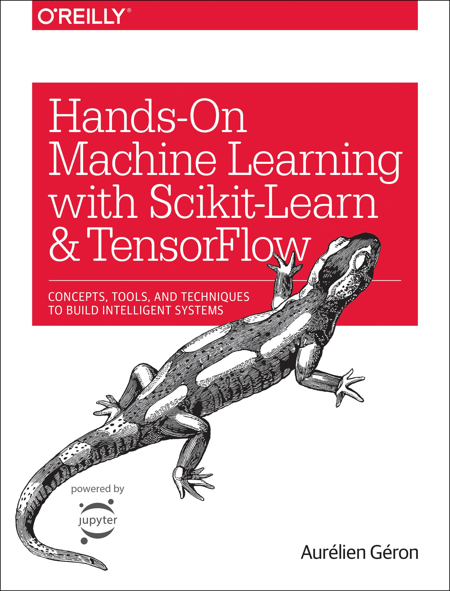
Reference
Chapter 14 (O'Reilly) of Hands-On ML
Youtube on MNIST
Youtube on CNN on MNIST
Youtube on Multilayer RNN on MNIST
Youtube on Multilayer LSTM on MNIST
Youtube on Multilayer GRU on MNIST
Youtube

Slide 3
Data

Slide 4
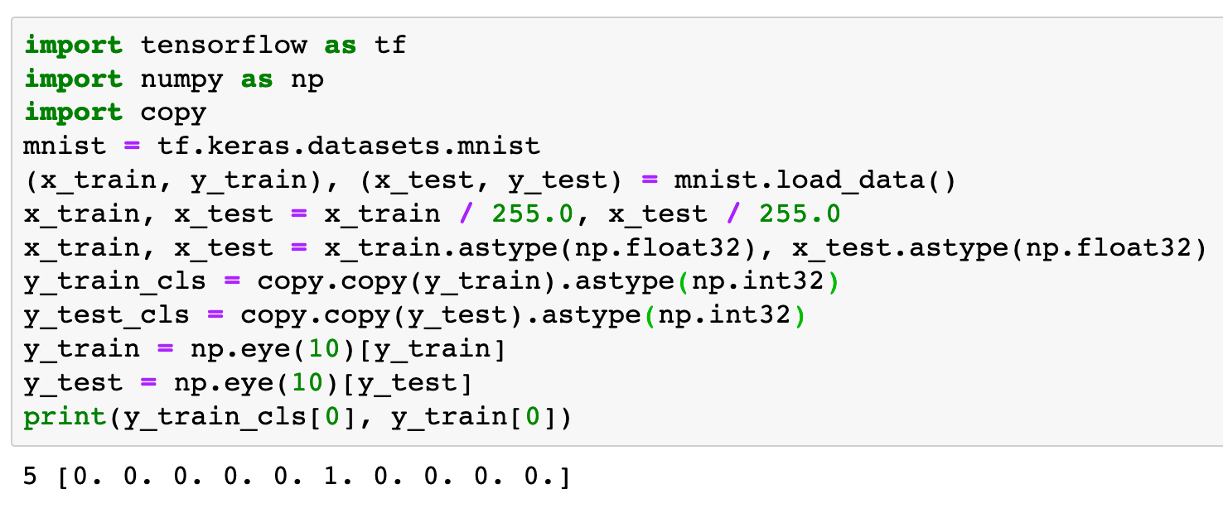

Slide 5
Warm Up

Slide 6
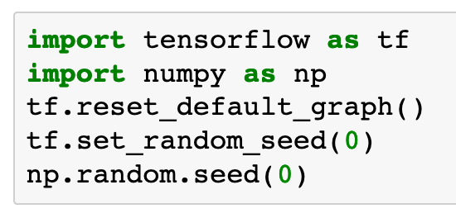

Slide 7
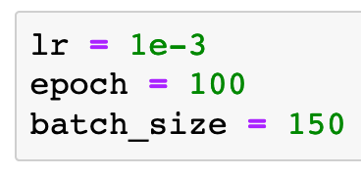

Slide 8
Graph

Slide 9
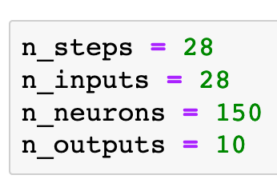
Previously

Slide 10
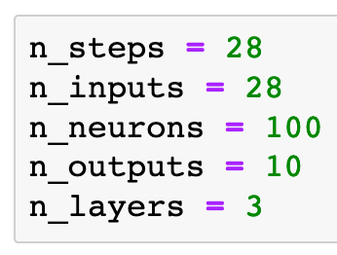
Previously
Now

Slide 11
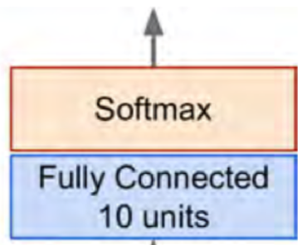
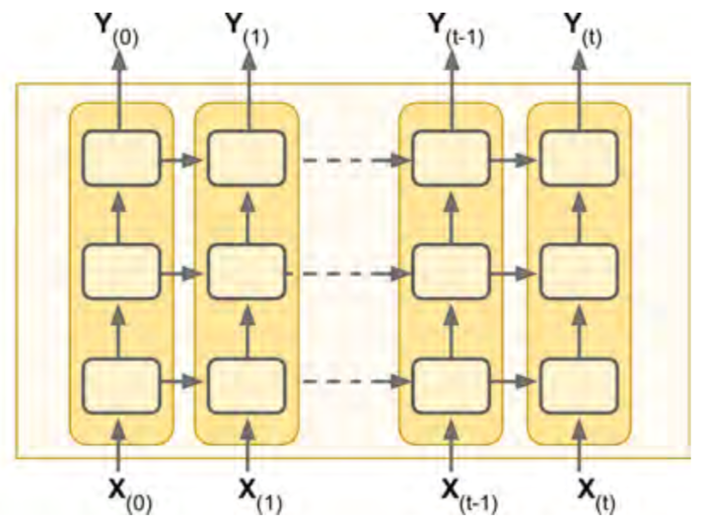
Previously
Now
Chapter 14 (O'Reilly) of Hands-On ML

Slide 12
Chapter 14 (O'Reilly) of Hands-On ML

Slide 13


Chapter 14 (O'Reilly) of Hands-On ML

Slide 14

Chapter 14 (O'Reilly) of Hands-On ML

Slide 15
Chapter 14 (O'Reilly) of Hands-On ML

Slide 16
Chapter 14 (O'Reilly) of Hands-On ML

Slide 17

Chapter 14 (O'Reilly) of Hands-On ML

Slide 18
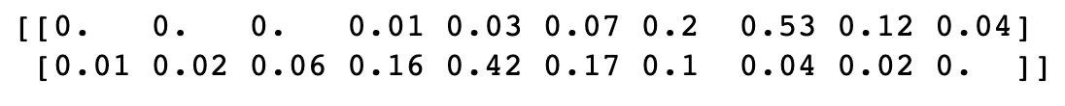
Chapter 14 (O'Reilly) of Hands-On ML

Slide 19
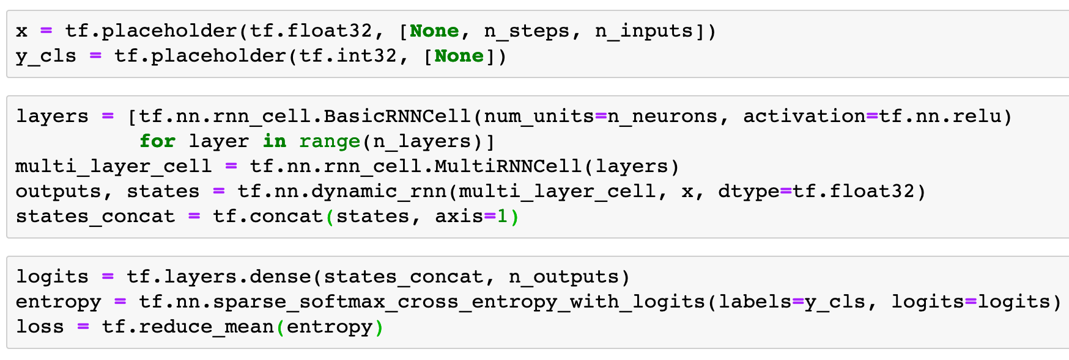
Multilayer RNN on MNIST

Slide 20
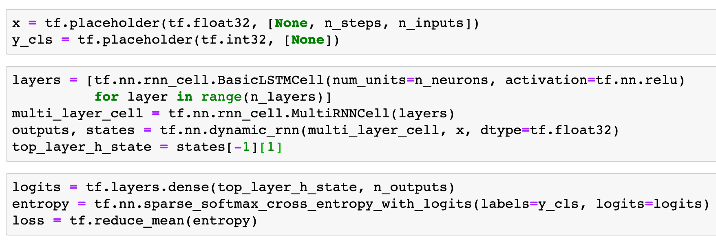
Multilayer LSTM on MNIST

Slide 21
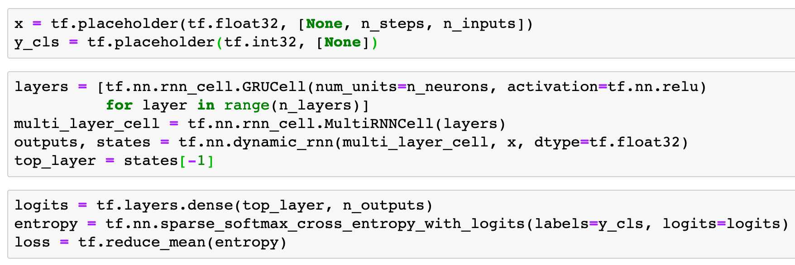
Multilayer GRU on MNIST

Slide 22
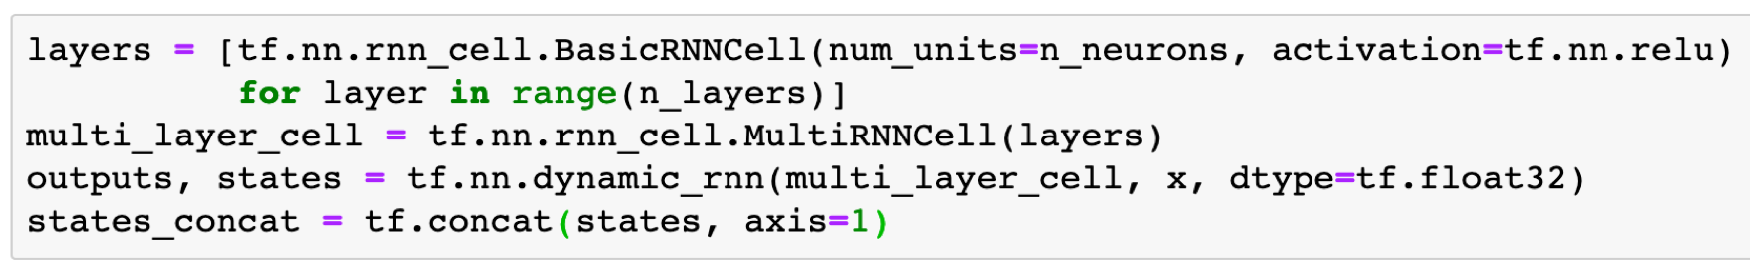
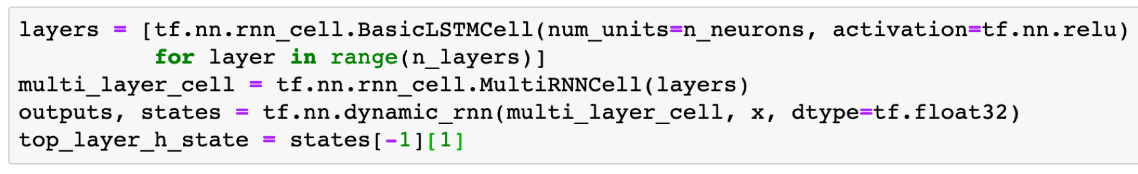
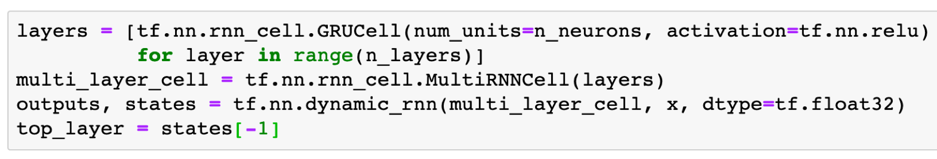
Multilayer RNN on MNIST
Multilayer LSTM on MNIST
Multilayer GRU on MNIST

Slide 23
Multilayer RNN on MNIST
Multilayer LSTM on MNIST
Multilayer GRU on MNIST

Slide 24
Multilayer RNN on MNIST
Multilayer LSTM on MNIST
Multilayer GRU on MNIST

Slide 25
Multilayer RNN on MNIST
Multilayer LSTM on MNIST
Multilayer GRU on MNIST

Slide 26
Multilayer RNN on MNIST
Multilayer LSTM on MNIST
Multilayer GRU on MNIST

Slide 27
Multilayer RNN on MNIST
Multilayer LSTM on MNIST
Multilayer GRU on MNIST

Slide 28
Multilayer RNN on MNIST
Multilayer LSTM on MNIST
Multilayer GRU on MNIST

Slide 29

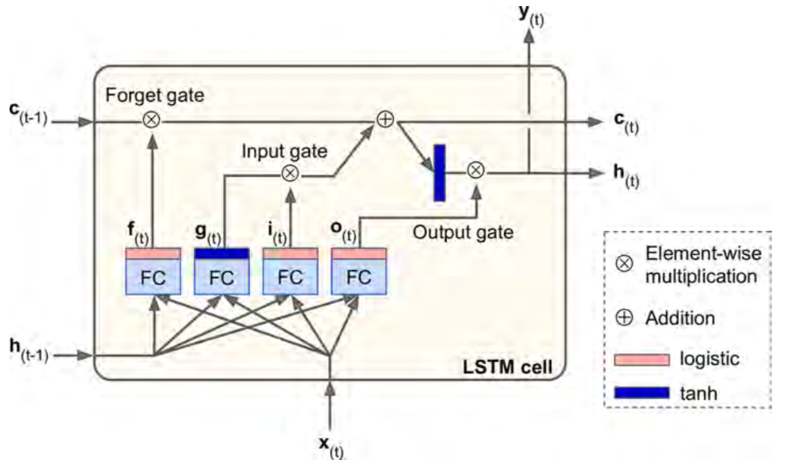
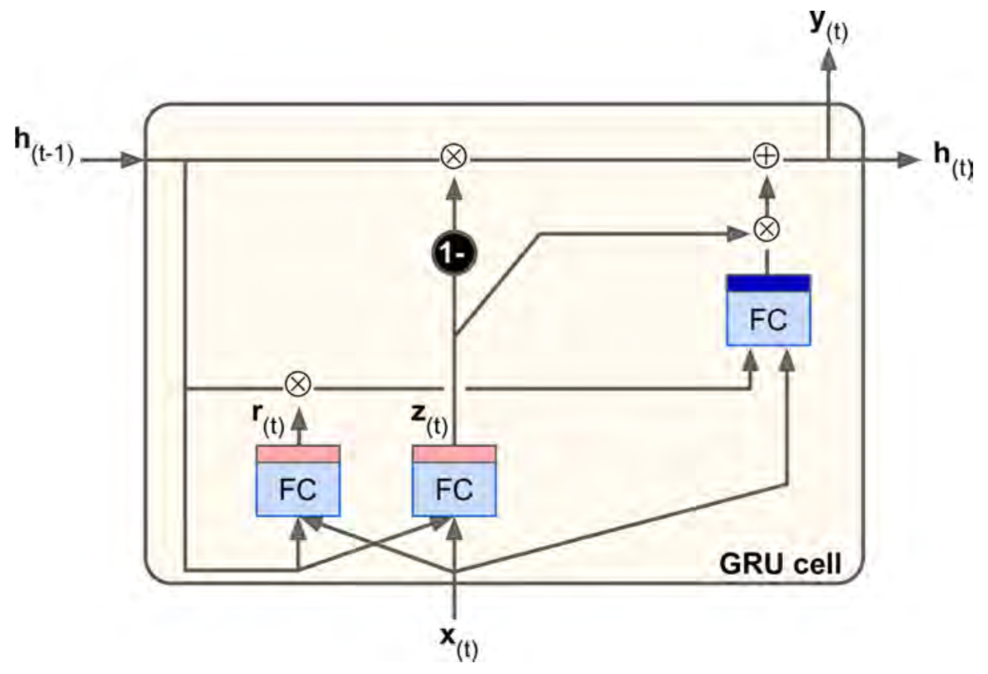
Chapter 14 (O'Reilly) of Hands-On ML
Chapter 14 (O'Reilly) of Hands-On ML
LSTM cell
GRU cell

Slide 30
Chapter 14 (O'Reilly) of Hands-On ML
Chapter 14 (O'Reilly) of Hands-On ML
LSTM cell
GRU cell

Slide 31
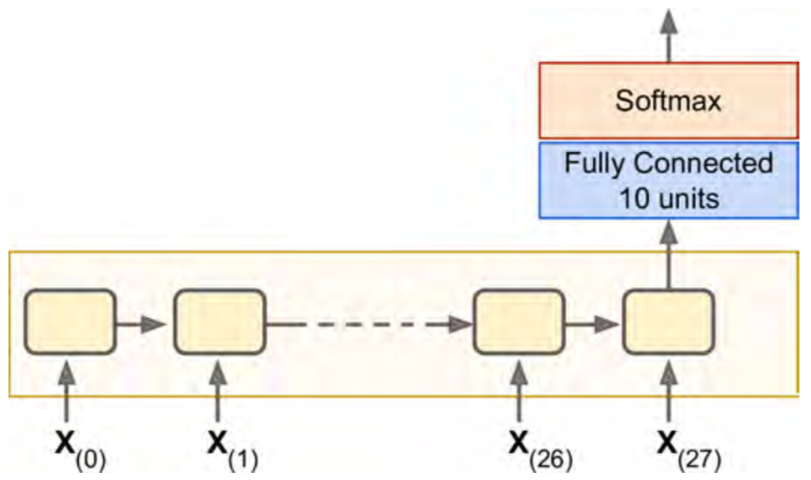
Chapter 14 (O'Reilly) of Hands-On ML

Slide 32

Chapter 14 (O'Reilly) of Hands-On ML

Slide 33
Chapter 14 (O'Reilly) of Hands-On ML
x

Slide 34
Chapter 14 (O'Reilly) of Hands-On ML
(?,28,28)
x

Slide 35
Chapter 14 (O'Reilly) of Hands-On ML
(?,28,28)
x

Slide 36
Chapter 14 (O'Reilly) of Hands-On ML
top_layer
(?,28,28)
x

Slide 37
Chapter 14 (O'Reilly) of Hands-On ML
top_layer
(?,100)
(?,28,28)
x

Slide 38
Chapter 14 (O'Reilly) of Hands-On ML
top_layer
(?,100)
(?,28,28)
x

Slide 39
Chapter 14 (O'Reilly) of Hands-On ML
logits
top_layer
(?,100)
(?,28,28)
x

Slide 40
Chapter 14 (O'Reilly) of Hands-On ML
(?,10)
logits
top_layer
(?,100)
(?,28,28)
x

Slide 41
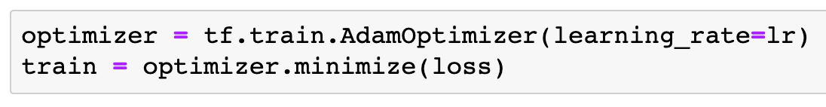

Slide 42
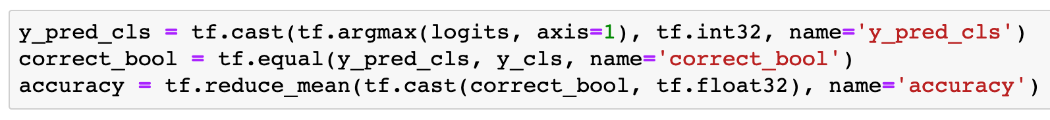

Slide 43
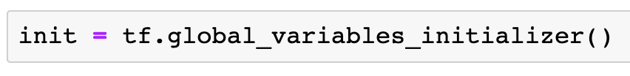

Slide 44
Session

Slide 45
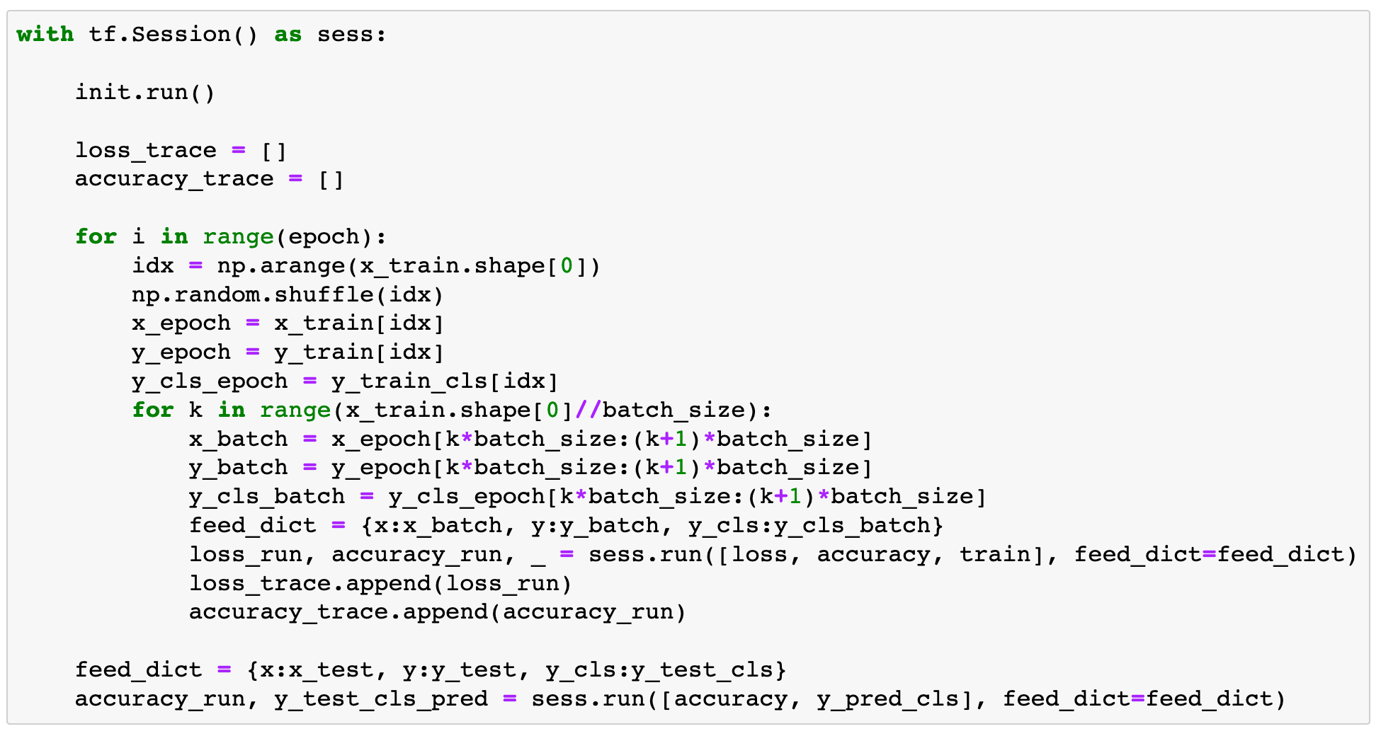

Slide 46
Report Result

Slide 47
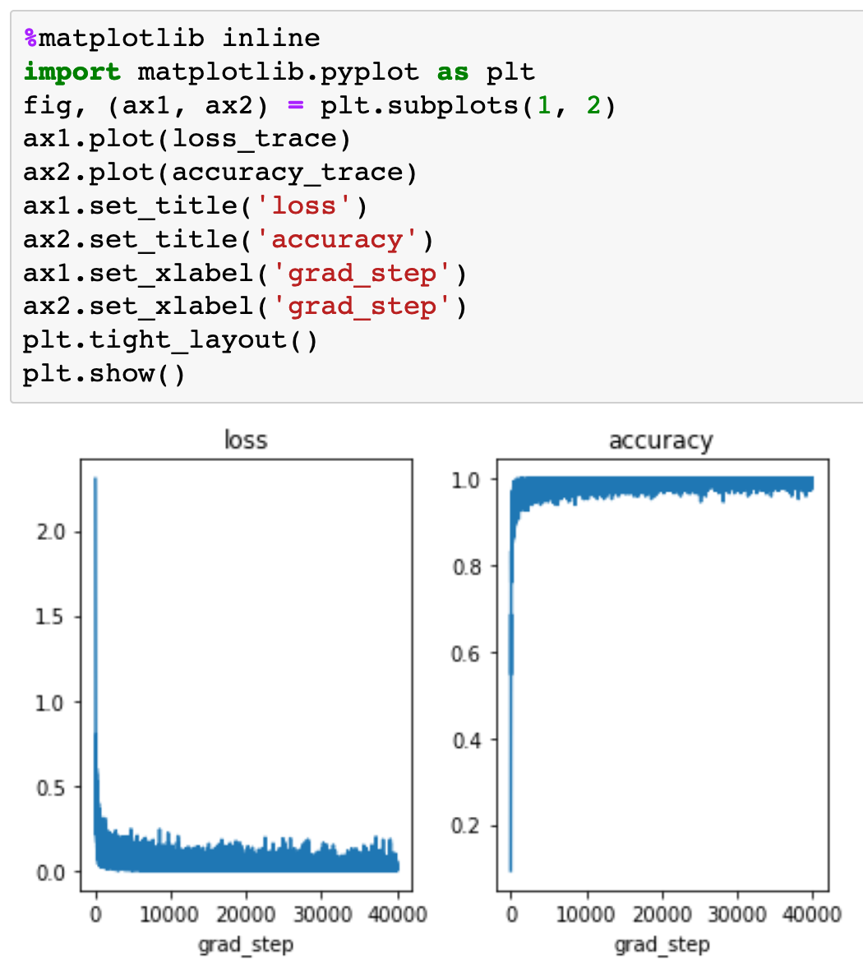
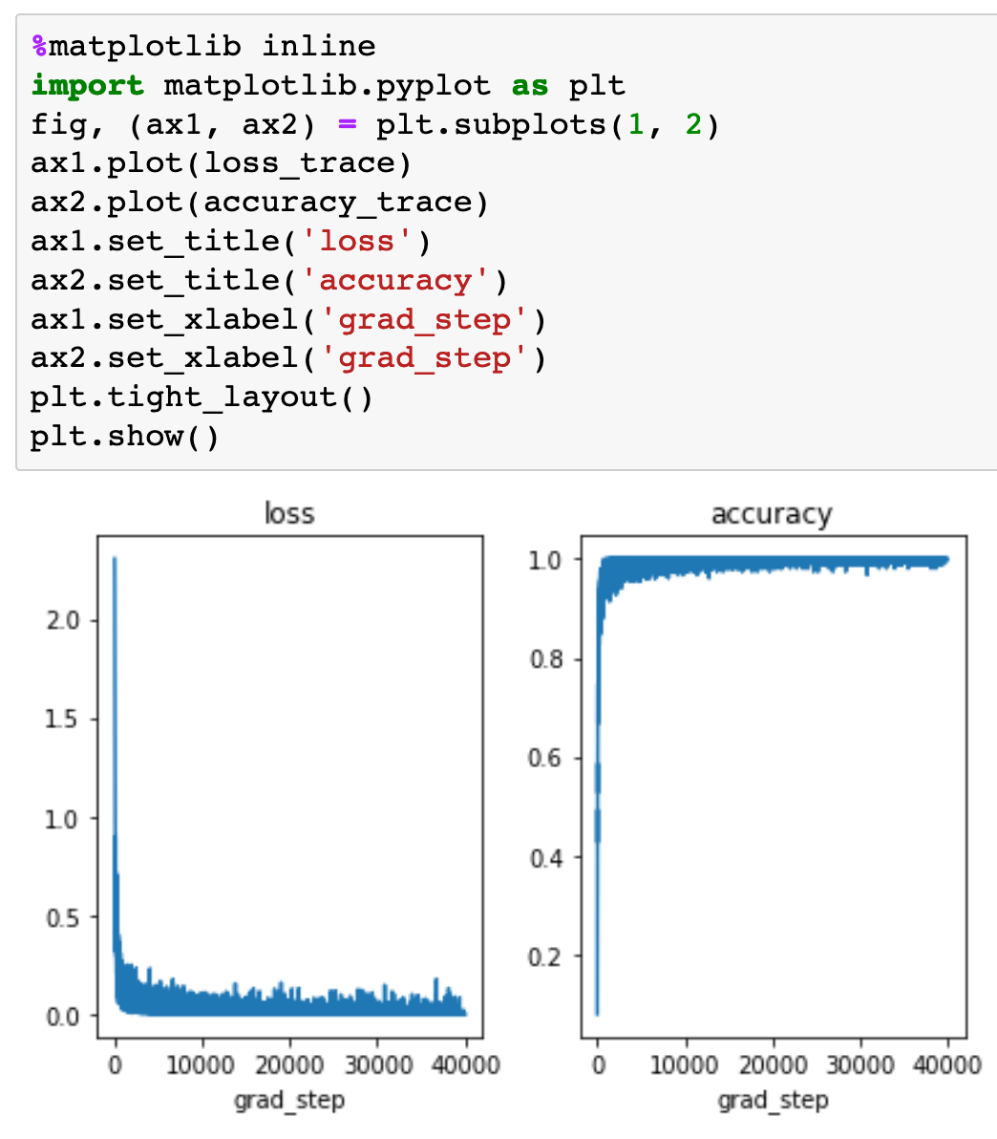

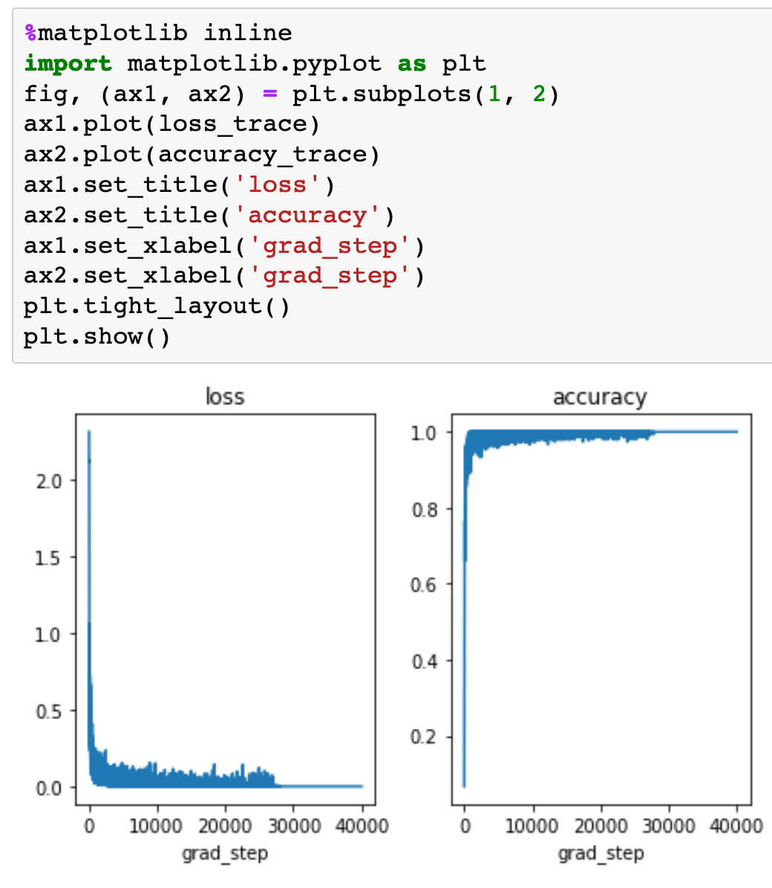
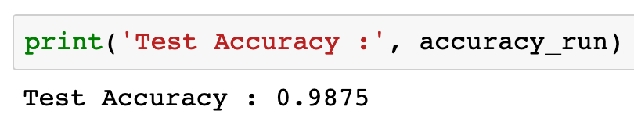
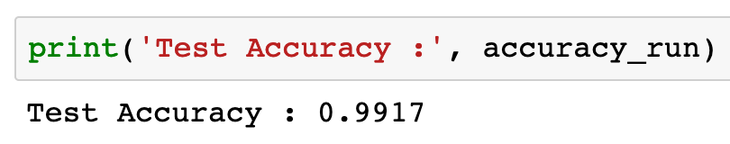
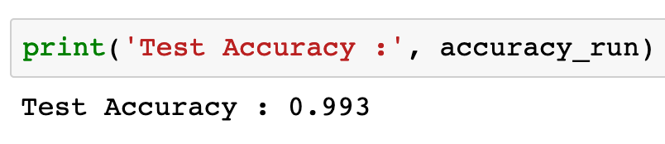
RNN
LSTM
GRU

Slide 48
RNN
LSTM
GRU

Slide 49
RNN
LSTM
GRU

Slide 50
RNN
LSTM
GRU

Slide 51
RNN
LSTM
GRU

Slide 52
RNN
LSTM
GRU

Slide 53
RNN
LSTM
GRU

Slide 54
Now
Let’s Play with Code

